Slide 1
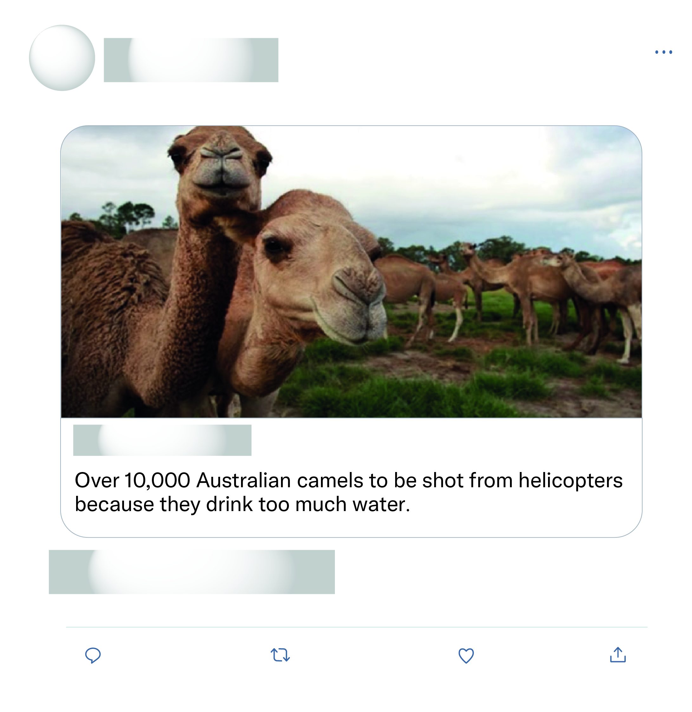








That's all the experts sat down and discussed as the solution wow what a productive move nothing else just killing more animals again after half a billion have died what a move.
This is just absolute nonsense!

Slide 2
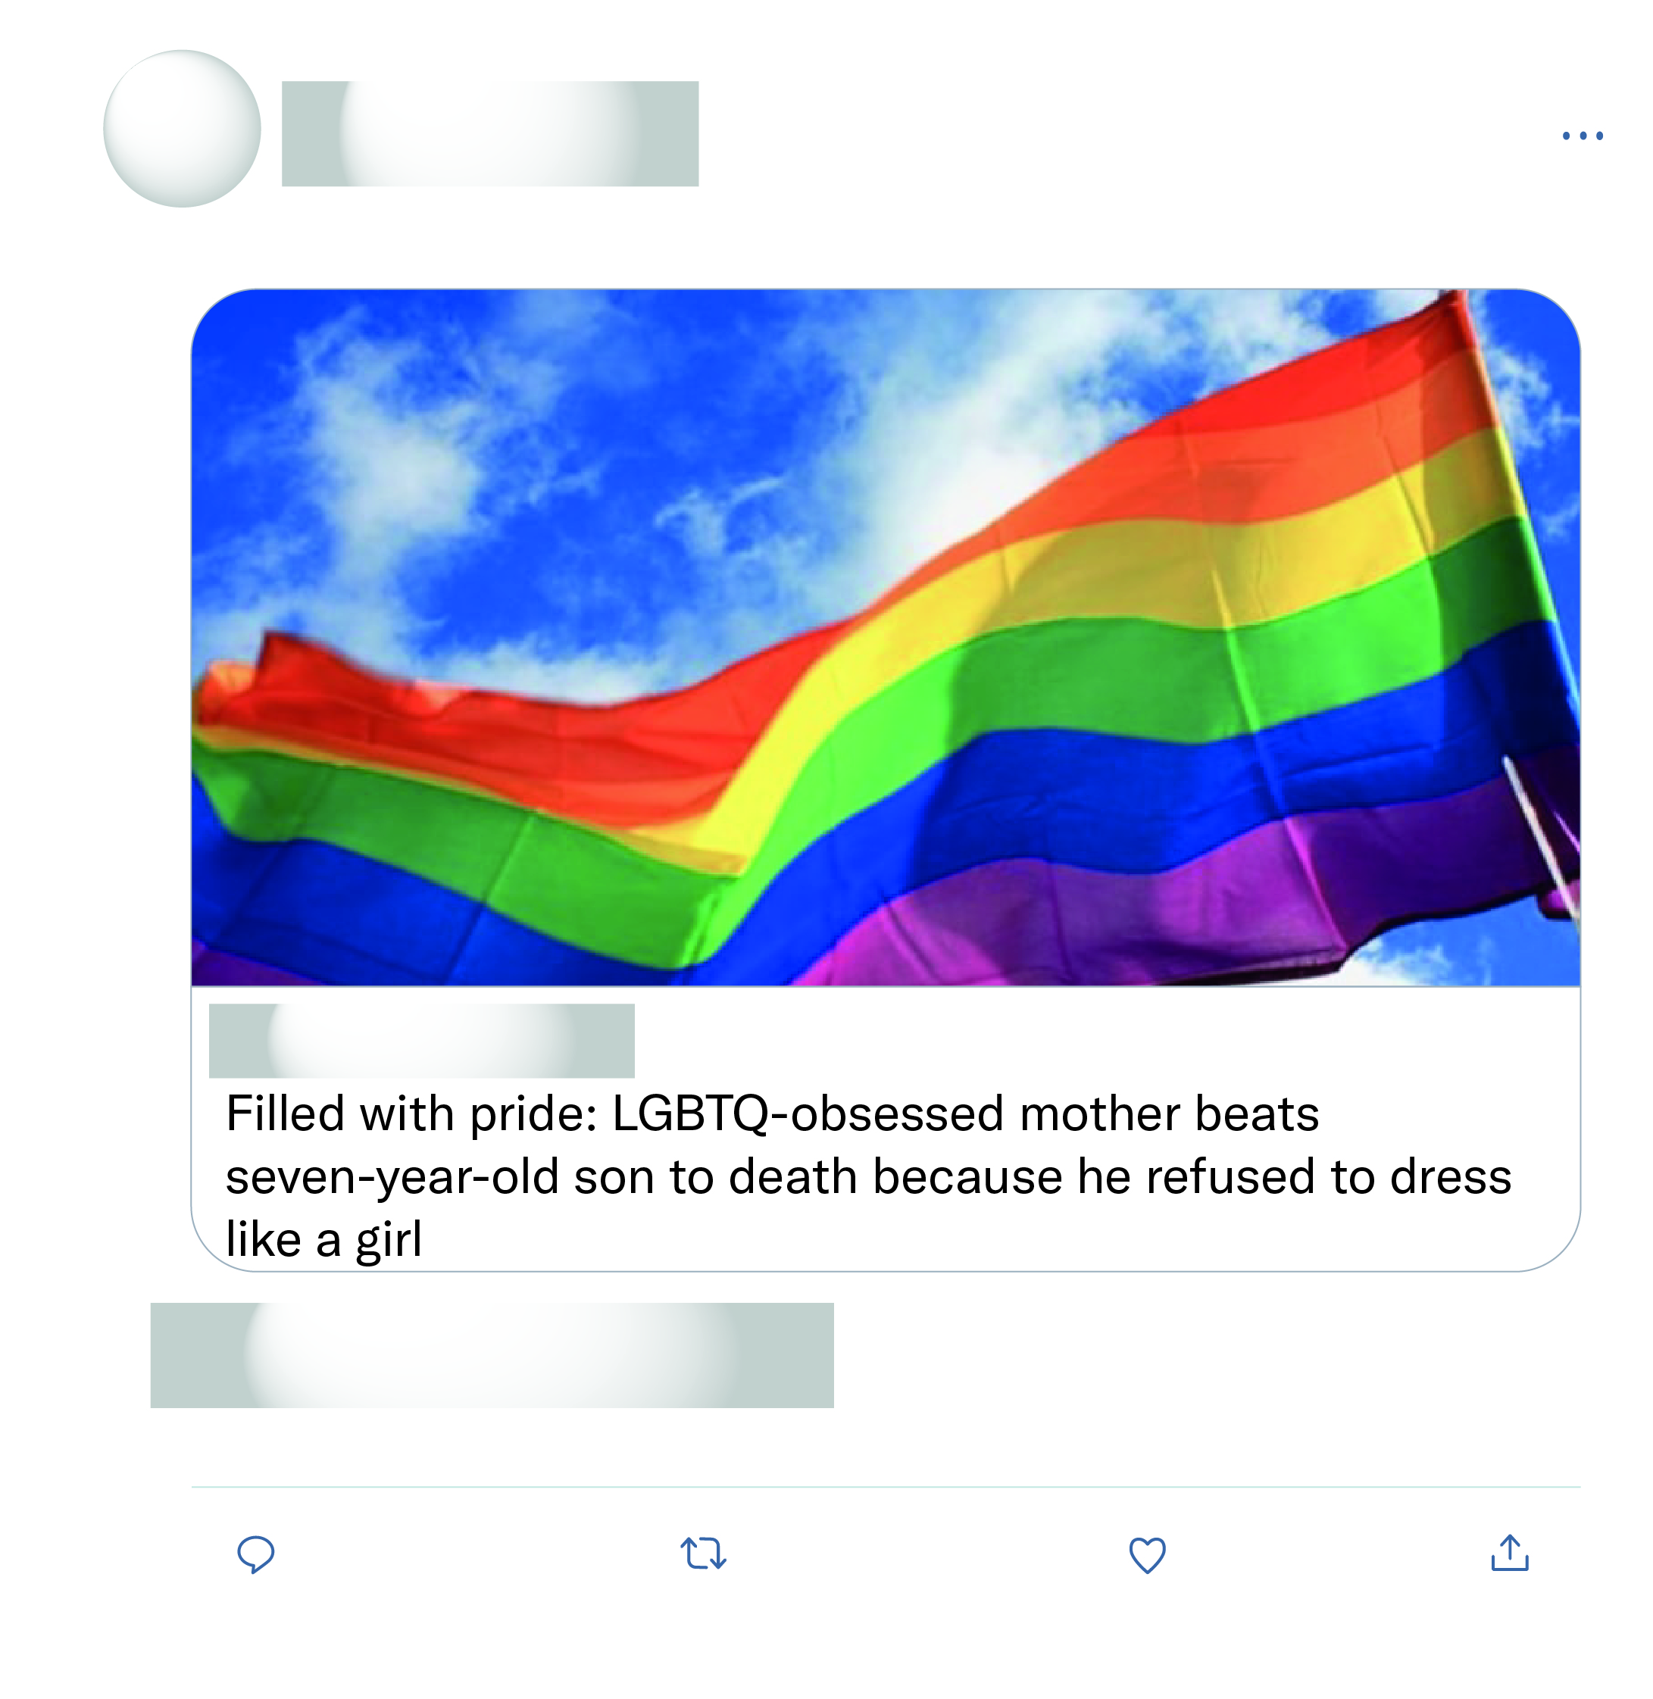
Read this exact story last year. Now it is being presented yet again (unsourced, no timeline) to fuel our outrage. I say it is just more BS.
Made up story to trigger hate towards the LGBTQ community!
This certainly shouldn't have happened, and this mother MUST be punished. But not all lgbt people are like that woman. Both in the lgbt and in the straight community there are a few sick people who do horrible things.
OMG, I couldn't read more than the first few lines of this before I wanted to throw up. Anyone who does this to an innocent child should be slowly burned to death.

